Slide 1
Characteristics of the Epic, Epic Hero, and Epic Hero’s Journey
The Odyssey

Slide 2
Writing Fluency #6
What qualities make someone a hero? Can you think of any modern-day heroes?

Slide 3
Learning Objective
The students will be able to list the characteristics of an epic.
The students will be able to apply the epic hero cycle to a modern work.

Slide 4
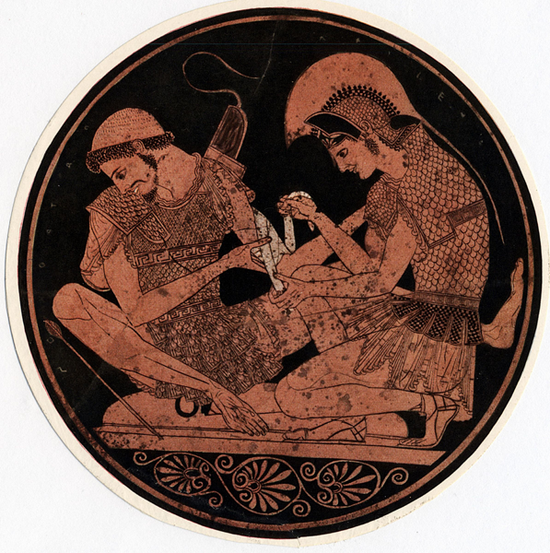
Epic Literature
Epics are long narratives told in elevated language, often relating the adventures of larger-than-life heroes.
In some way, epic heroes embody the values of their civilizations.
For example, a hero may demonstrate values of strength, bravery, or intelligence.
[End of Section]

Slide 5
Two Types of Epics
Folk Epic- oral compositions passed on from storyteller to storyteller and has changed over time. Ex. – Gilgamesh, Beowulf, the Iliad, and the Odyssey
2. Literary Epic- written compositions that are unchanged over time.
Ex. -Aeneid and Paradise Lost, Harry Potter and Lord of the Rings
.
[End of Section]

Slide 6
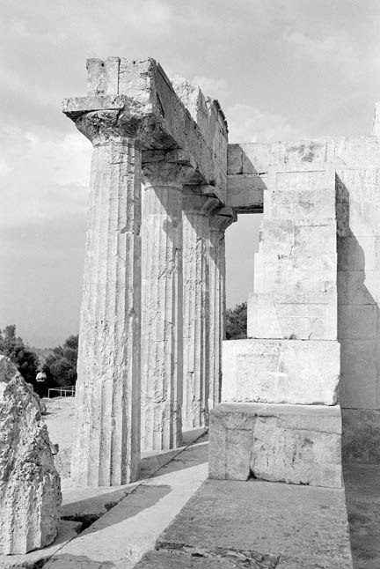
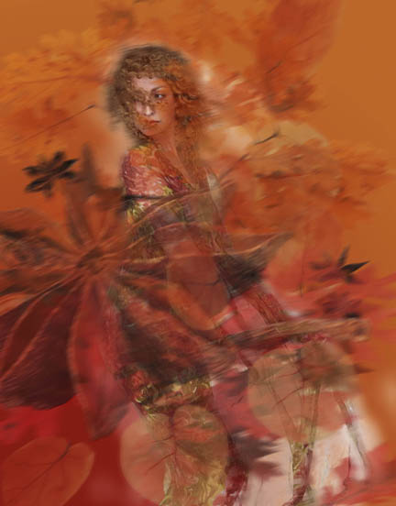
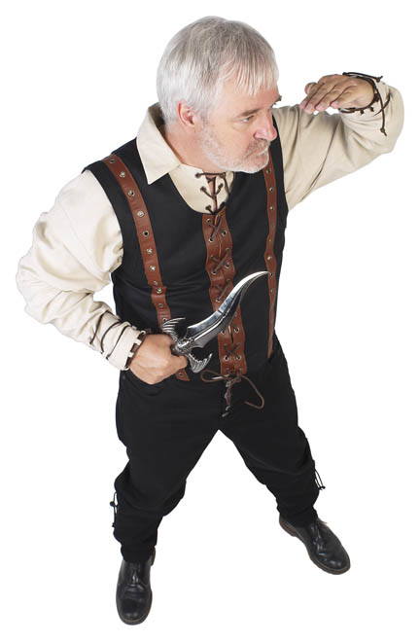
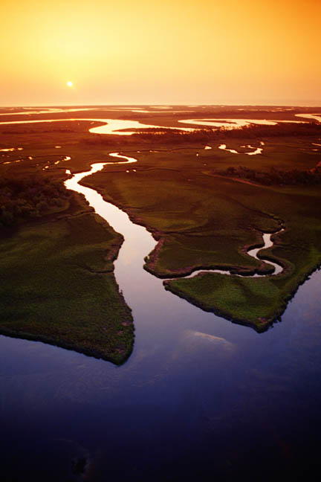
Elements of Epics
Epics are found in many cultures and share the following characteristics:
a physically impressive hero of national or historical importance
a vast setting
a quest or journey in search of something of value
the involvement of supernatural forces
a basis in a specific culture or society
characters struggling against fate

Slide 7
Epic Characters
The epic hero, who represents the values of a society, is at the center of every epic.
Epic heroes are exceptional people who undertake difficult quests or journeys..
Through the journey, heroes aim to achieve something of value to themselves or their people.
Epic heroes may experience many obstacles, or conflicts, along the way.
These conflicts are sometimes external, created by forces of nature or, as in many epics and myths, the gods.
Epic heroes also experience internal conflict.
Faced with an internal conflict, the heroes struggle to overcome their own fears or doubts.

Slide 8
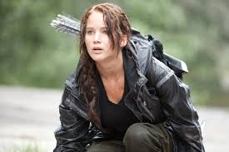
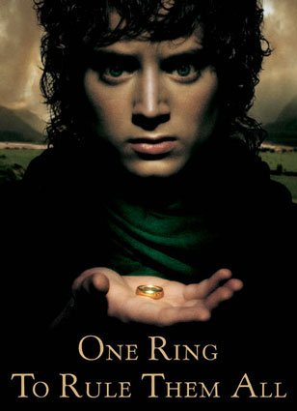
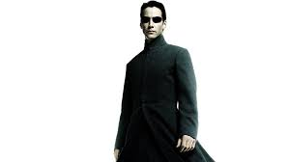
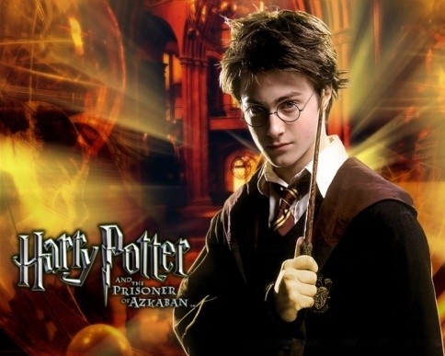
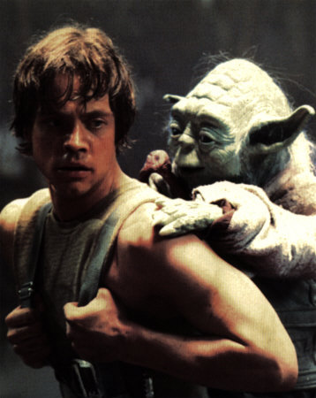
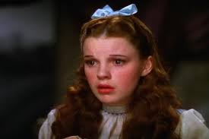
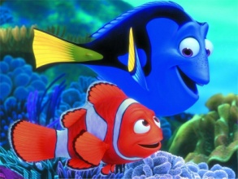
Modern Epics

Slide 9
Epic Hero Cycle

Slide 10
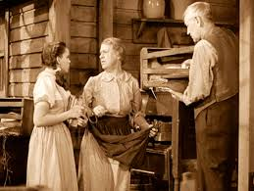
The Ordinary World
The hero, uneasy, uncomfortable or unaware, is introduced sympathetically so the audience can identify with the situation or dilemma. The hero is shown against a background of environment, heredity, and personal history. Some kind of polarity in the hero’s life is pulling in different directions and causing stress.

Slide 11
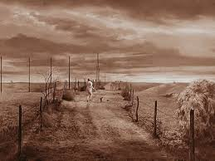
The Call to Adventure
Something shakes up the situation, either from external pressures or from something rising up from deep within, so the hero must face the beginnings of change.

Slide 12
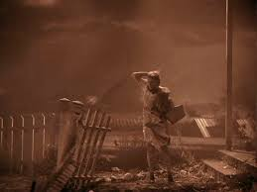
The Refusal of the Call
The hero feels the fear of the unknown and tries to turn away from the adventure, however briefly. Alternately, another character may express the uncertainty and danger ahead.

Slide 13
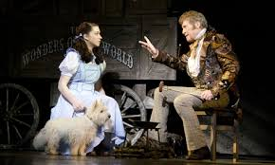
Meeting with the Mentor
The hero comes across a seasoned traveler of the worlds who gives him or her training, equipment, or advice that will help on the journey. Or the hero reaches within to a source of courage and wisdom.

Slide 14
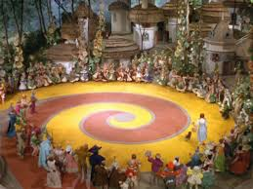
Crossing the Threshold
At the end of Act One, the hero commits to leaving the Ordinary World and entering a new region or condition with unfamiliar rules and values.
The hero meets a character that act as Threshold Guardians.

Slide 15
Challenges and Temptations
TESTS, ALLIES AND ENEMIES. The hero is tested and sorts out allegiances in the Special World.
APPROACH. The hero and newfound allies prepare for the major challenge in the Special world.
THE ORDEAL. Near the middle of the story, the hero enters a central space in the Special World and confronts death or faces his or her greatest fear. Out of the moment of death comes a new life.
THE REWARD. The hero takes possession of the treasure won by facing death. There may be celebration, but there is also danger of losing the treasure again.

Slide 16
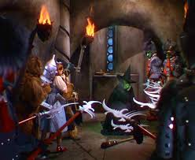
The Road Back
About three-fourths of the way through the story, the hero is driven to complete the adventure, leaving the Special World to be sure the treasure is brought home. Often a chase scene signals the urgency and danger of the mission.

Slide 17
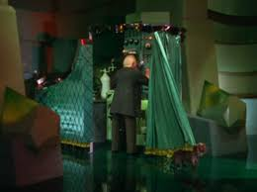
The Resurrection
At the climax, the hero is severely tested once more on the threshold of home. He or she is purified by a last sacrifice, another moment of death and rebirth, but on a higher and more complete level. By the hero’s action, the conflicts that were in conflict at the beginning are finally resolved

Slide 18
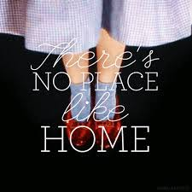
The Return with Knowledge
The hero returns home or continues the journey, bearing some element of the treasure that has the power to transform the world as the hero has been transformed.

Slide 19
Group Work
In small groups you will examine a story with which you are familiar. Using your chosen story, complete the handout with events from the story that correspond to the different phases of the Hero’s Journey.
Possible choices:
Harry Potter The Lord of the Rings
Star Wars The Hunger Games
Shrek Finding Nemo
The Matrix Others upon approval

