Slide 1
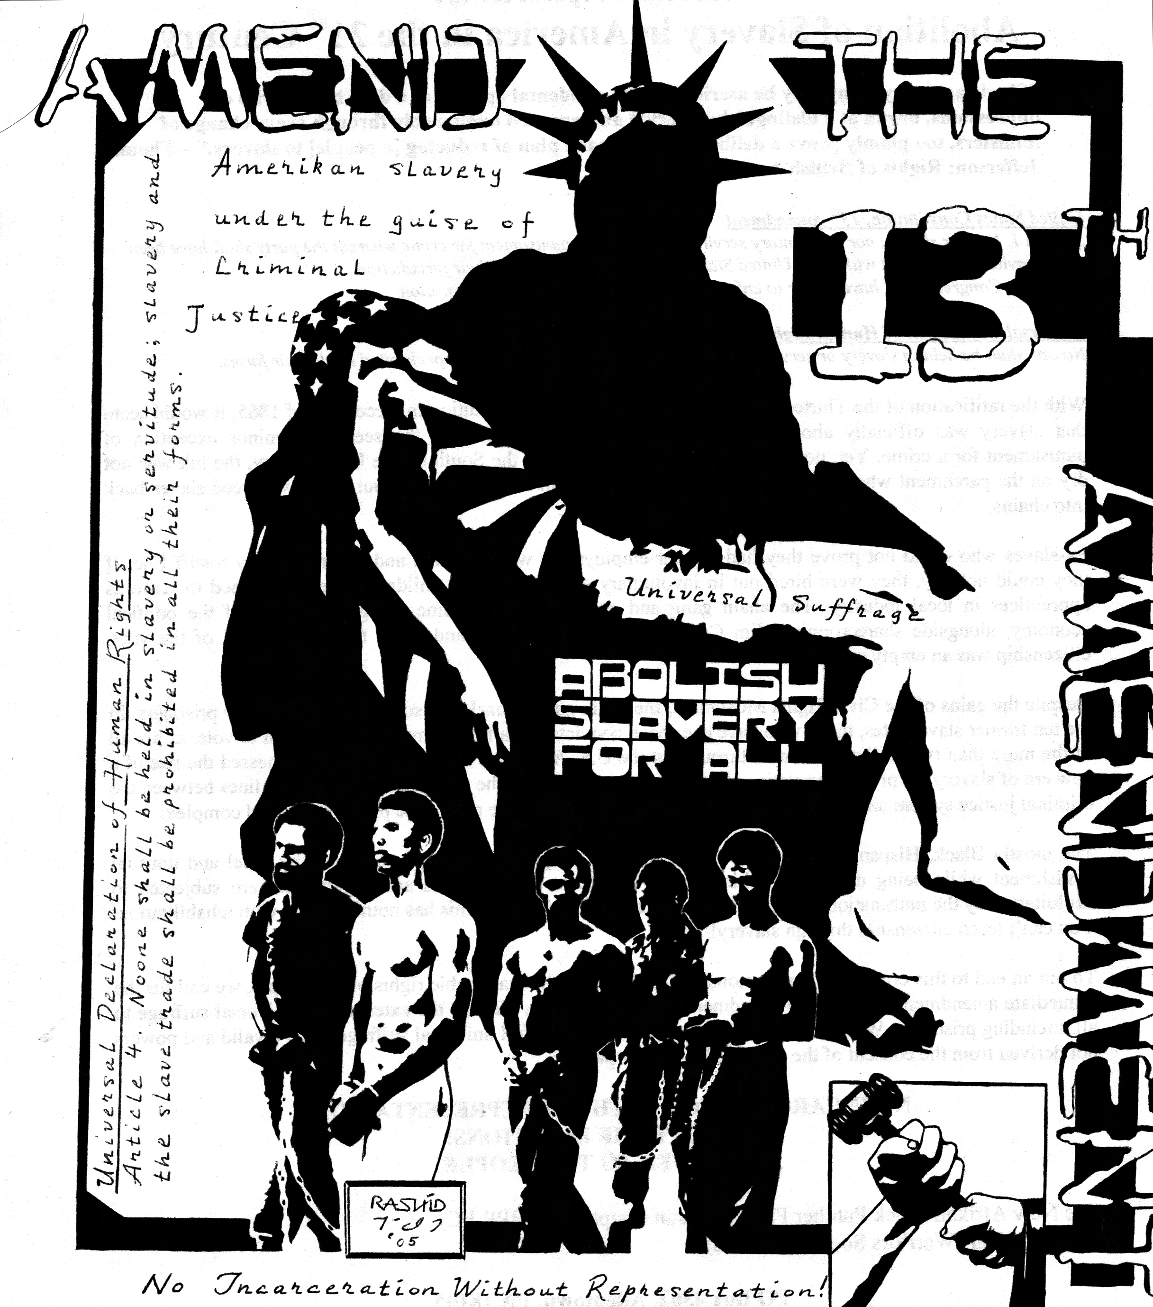
1865 – The 13th Amendment, “black codes”

Slide 2
1896 – Plessy vs. Ferguson

Slide 3
1931 – Scottsboro Trials

Slide 4
1954 – Brown vs. Board of Education

Slide 5
1954 – Brown vs. Board of Education

Slide 6
1955 – Emmett Till

Slide 7
1955 Rosa Parks The Bus Boycott

Slide 8
1960 – To Kill A Mockingbird

Slide 9
Birmingham 1963

Slide 10
March on Washington 1963

Slide 11
Church Bombing-JFK Assignation 1964

Slide 12
Martin Luther King 1965

Slide 13
MLK Assassinated 1968

