Slide 1
Types of discrimination
Ms. Dombrow
Eng. 9B

Slide 2
Discrimination
“to make a distinction in favor of or against a person or thing on the basis of the group, class, or category to which the person or thing belongs rather than according to actual merit.” – Dictionary.com
Essentially, acting out on one’s prejudices

Slide 3
Racism
Treating people of another race unfairly
See people of another race as “less than”
Examples?

Slide 4
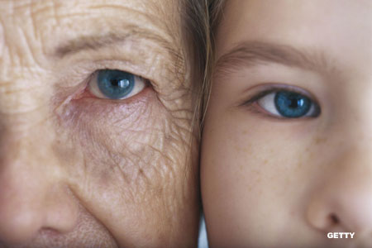
Ageism
Treating someone unfairly based on his/her age
Examples?

Slide 5
Sexism
Treating someone unfairly based on his/her gender
Sexism is typically against women, but men suffer from this as well
Gender roles
Examples?
https://www.youtube.com/watch?v=XjJQBjWYDTs

Slide 6
Elitism
Treating someone unfairly based on his/her economic status
Thinking you belong to the elite group
Examples?

Slide 7
Ableism
Treating people unfairly who have a disability
Physical and mental disabilities both apply
Examples?

Slide 8
Now it’s time to speak out
Choose an “ism” of discrimination to write a letter to
Your letter should include:
Dear ____ “ism” _____
Specific examples of how the “ism” has affected your life or the life of someone you know
Ways to eliminate or lessen the ”ism”
A salutation (Sincerely)
Your letter should be 1-2 pages
Grammar matters

